Slide 1
Comparison among five evolutionary-based optimization algorithms
Emad Elbeltagi, Tarek Hegazy and Donald Grierson
Advanced Engineering Informatics, vol. 19, pp. 43-53, 2005
Presenter: Yung-Hsing Peng
Date: Dec. 21, 2006

Slide 2
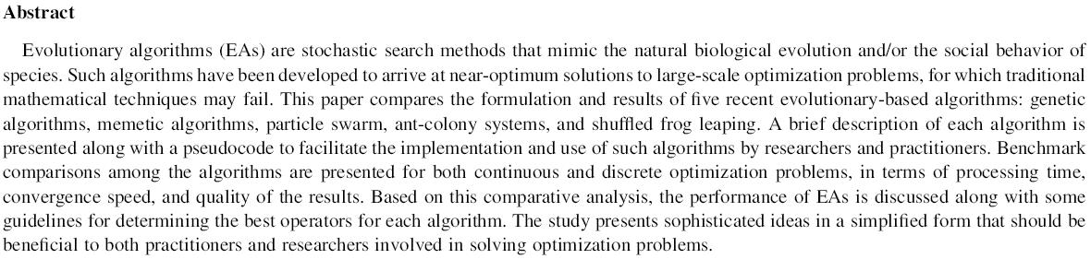

Slide 3
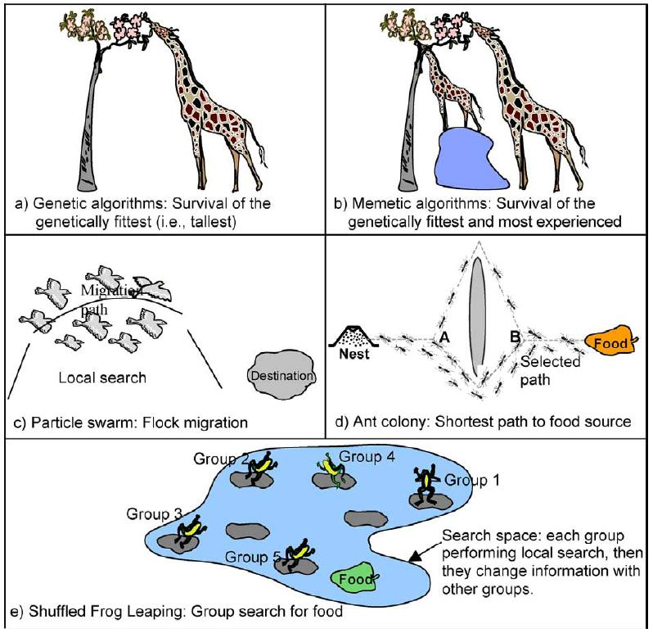
Evolutionary-based Optimization Algorithms

Slide 4
Problem for Example
Finding the minima of y=x² using 8 bits
Optimal solution: 00000000
Initial solutions are produced by random function.
Ex: 01100011, 10001101, 00100111, 00011000

Slide 5
Genetic Algorithms (GA)
Crossover ©: select parents and produce their offspring
Ex: 01100011 © 00011000 → 00100001
Mutation: 00100001 → 00000001
GA adopts crossover to produce more solutions, among which some can mutate. By removing bad solutions in each generation, good solutions survive.

Slide 6
Memetic Algorithms (MA)
Local Search:
Method 1: 00011000 → 00001001 (Single Swap)
Method 2: 00011000 → 00000000 (Partial Minus)
You can devise your own local search.
MA adopts local search to each solution. If the result of a local search is better, then replace the worst solution with this result.

Slide 7
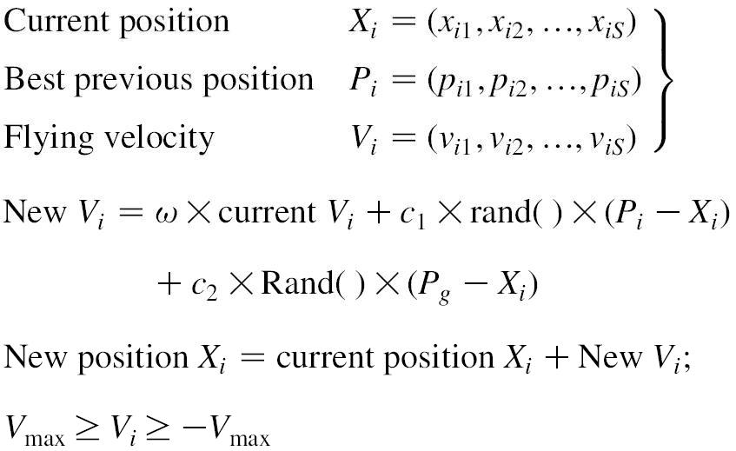
Particle Swarm Optimization (PSO)
Move! Not remove!
P_{i}: The best experience of bird i. (local best)
P_{g}: The position of the best bird. (global best)
PSO is suitable if a solution can be represented by a vector.

Slide 8
Ant Colony Optimization (ACO)
Start
0
0
0
0
0
0
0
0
B1
B2
B3
B4
B5
B6
B7
B8
END
1
1
1
1
1
1
1
1
Example path: 01001100
First, each edge is given its initial pheromone.
Each ant completes its own path according to pheromone.
After measuring the fitness of its path, each ant leaves pheromone on visited edges.
ACO was designed for TSP.

Slide 9
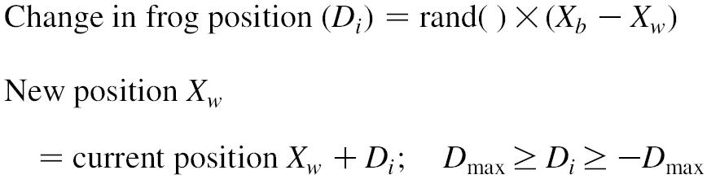
Shuffled Frog Leaping Optimization (SFLO)
First, SFLO produces P frogs and partition them into m groups (memeplexes).
SFLO combines the idea of MA and PSO.
In each memplex, only “the worst” frog moves.
X_{b}: the best frog in a memeplex (local best)
X_{w}: the worst frog in a memeplex (local worst)
X_{g}: the best frog from a global view (global best)
When no improvement is made at new position, replace X_{b} with X_{g} and try again.
If there’s still no improvement, randomly transport the worst frog.

Slide 10
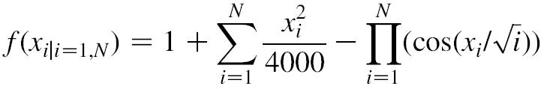
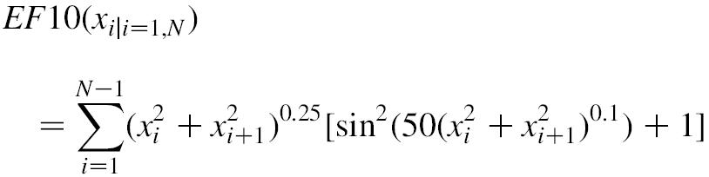
Experiment I
F8 function
EF10 function
Find the minimum for both functions using various evolutionary algorithms.
→ Optimal solution: setting every variables to zero obtains the minima zero.

Slide 11
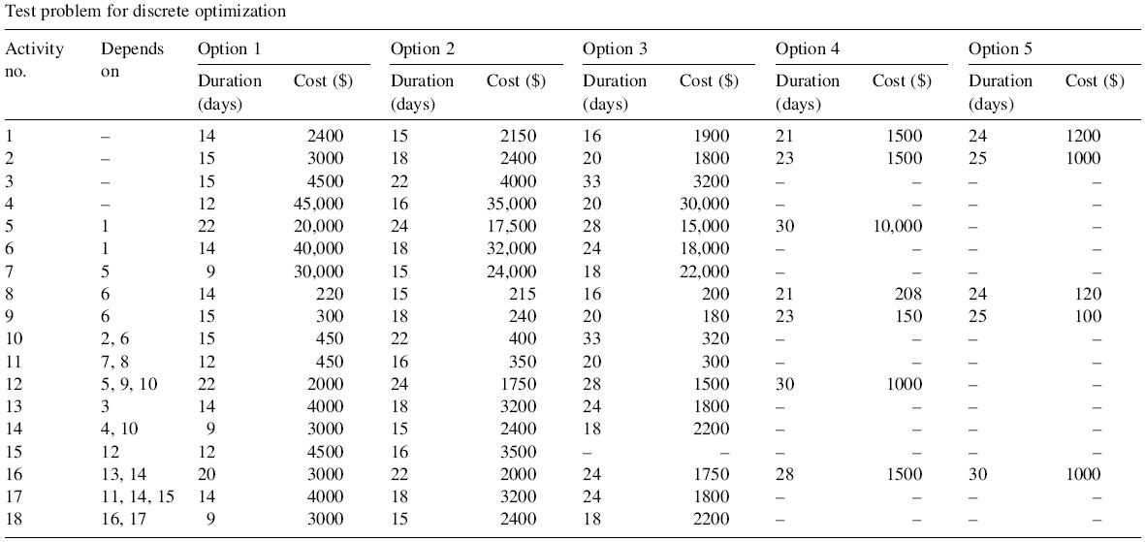
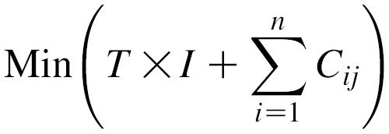
Experiment II
T: total duration in days
I: daily cost
C_{ij}: Cost of activity i adopting option j
How about dynamic programming?

Slide 12
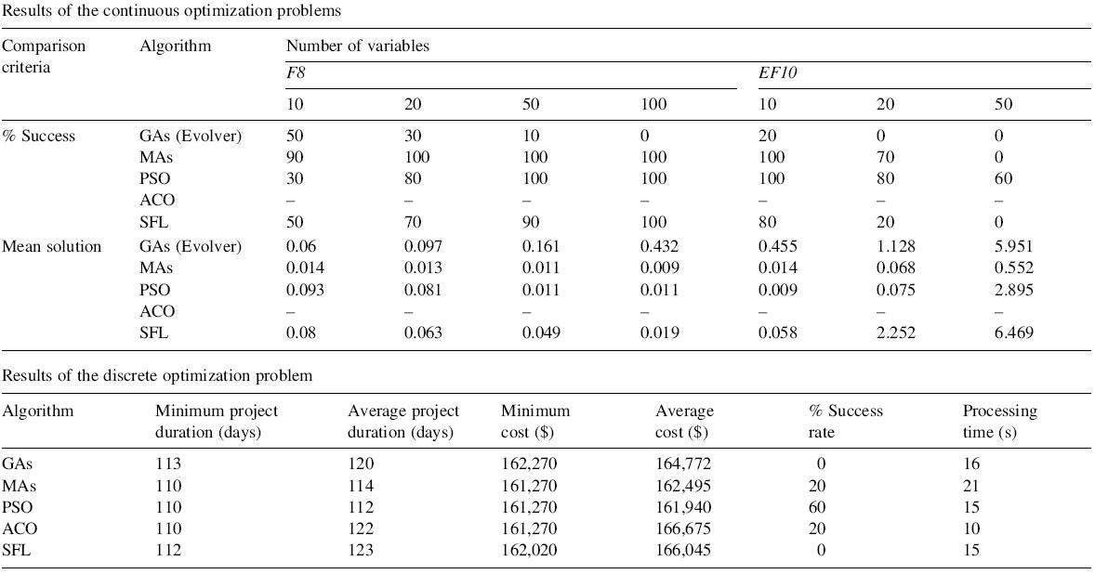
Experimental Results
In these experiments, PSO achieves the best performance.

